Slide 1

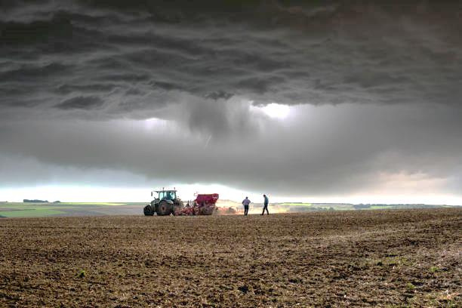


RAIN PREDICTION MODEL USING MACHINE LEARNING
Discover the power of machine learning in weather forecasting!
Done by-
Aida Sharon Bruce :- 21SCSE1011272

Slide 2



CONTENTS
INTRODUCTION
OBJECTIVE
IMPORTANCE
PROCESS
OVERVIEW
RESULT and FINDING
CONCLUSION

Slide 3

Introduction
Rain prediction is a crucial aspect of weather forecasting that has significant implications for various industries and everyday life. Accurate and timely prediction of rainfall can help in various sectors like agriculture and disaster preparation. Traditional methods of weather prediction rely on meteorological instruments and numerical weather models, but in recent years, machine learning techniques have emerged as effective tools for improving the accuracy of rain prediction.
It involves the development of algorithms that can learn patterns and make predictions or decisions based on data. The models can be trained on historical weather data and used to predict rainfall for future time periods.

Slide 4

Project Goals
1. Timely Predictions:
Provide timely and advance warnings of rainfall events to support preparedness and decision-making.
2. Accuracy Improvement:
Enhance the accuracy of rainfall predictions compared to traditional meteorological methods.
Minimize false positives and false negatives in rain predictions.
3. Robustness to Data Variability:
Ensure the model's robustness to variations in data quality, missing values, and outliers, which are common challenges in meteorological datasets.
4. Continuous Learning and Updating:
Implement mechanisms for continuous learning and updating of the model to adapt to changing weather patterns and improve prediction accuracy over time.

Slide 5
Importance
The importance of a rain prediction model is evident in various aspects of society and different industries. Here are some key reasons why rain prediction models are essential:
Disaster Preparedness
Agriculture Planning
Water Resource Management
Infra-Structure Planning
Economic Impact
Environmental Conservation

Slide 6

Process
Problem Definition
Data Collection
Data Cleaning and Pre-processing
Exploratory Data Analysis
Feature Engineering
Data Splitting
Model Selection
8. Model Tuning
9. Hyperparameter Tuning
10. Model Evaluation
11. Real-Time Testing
12. Deployment
13. Monitoring and Maintenance
14. Documentation

Slide 7
Project Overview
Libraries Used:
Numpy
Pandas
Seaborn
Matplotlib
Sklearn
Historical Data:
file_path = "C:\\Users\\pande\\Downloads\\Historical Weather API Data.csv"
Algorithm Used:
Random Forest Approach

Slide 8
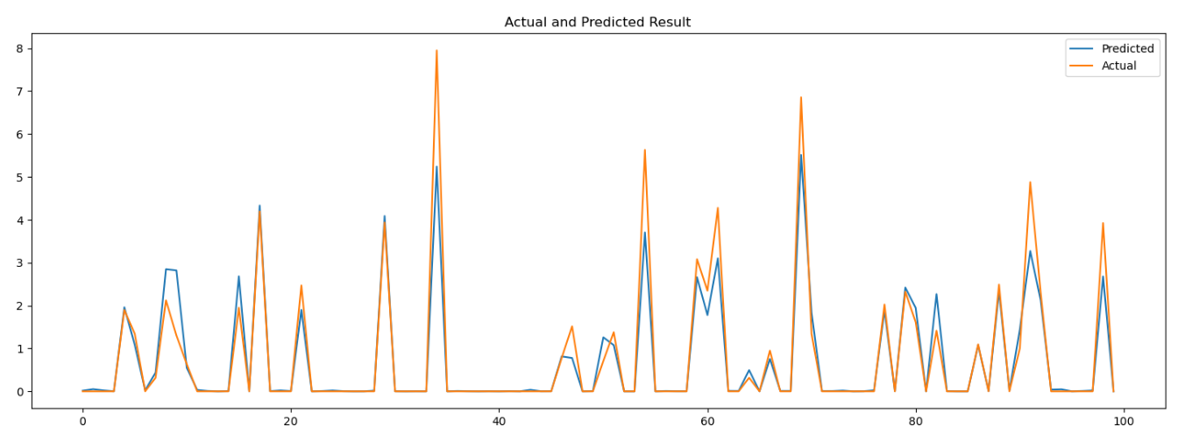
Result and Finding

Slide 9
Conclusion
In conclusion, the development and implementation of a rainfall prediction model using machine learning represent a significant advancement in the field of meteorology and have far-reaching implications for numerous sectors. The accuracy and timeliness of rain predictions provided by these models offer substantial benefits across various domains.
The predictive capabilities of machine learning models to forecast rainfall events in advance allows for proactive measures to be taken, minimizing the impact on public safety, agriculture, infrastructure, and the environment.

Slide 10
THANK YOU

